Slide 1
Power quality analysis
Presented by: V. Samuel Cripps

Slide 2
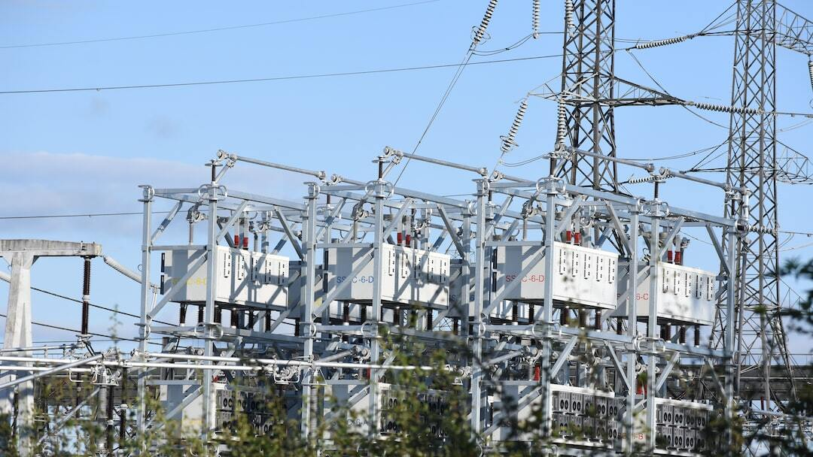
introduction
Definition of Power Quality: IEEE defines Power Quality as “The concept of powering and grounding electronic equipment in a manner that is suitable to the operation of that equipment and compatible with the premise wiring system and other connected equipment.”
Importance: Good power quality is crucial for the reliable operation of electrical equipment, minimizing disruptions, and reducing costs associated with poor power quality.

Slide 3
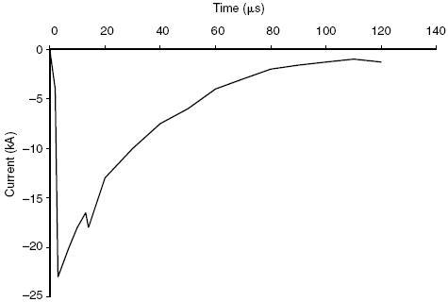
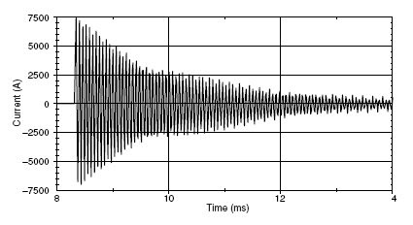
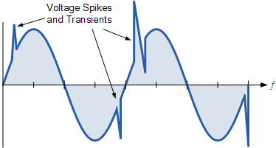
Key Factors responsible for Power quality disturbances
VOLTAGE | HARMONICS | INTERRUPTIONS | TRANSIENTS
Over voltage: Occurs when the voltage level exceeds the normal range, which can damage electrical equipment. | What are Harmonics? Harmonics are voltage or current waveforms at frequencies that are multiples of the fundamental frequency, causing distortion in the power system. | Voltage imbalance: It is the deviation of magnitude and/or phase of one or many phases, of a three phase wrt the magnitude of the other phases and the normal phase angle(120 degree). | What are trnsients? Transient is an undesirable momentary deviation of supply voltage or load current. Such phenomena exists for a very short duration from less than 50 nanoseconds to as long as 50 milli seconds.
Under voltage: Occurs when the voltage level drops below the normal range, leading to inefficiencies and potential equipment failure. | Sources: Common sources include nonlinear loads such as diode bridge rectifiers, variable frequency drives, and fluorescent lighting. | An Outage is defined as an interruption that has duration lasting more than one minute. A power outage (also known as power cut, power failure, power blackout, power loss) is the loss of electrical power supply to an end user. | Sources: Lightning strikes, switching activities like opening and closing of disconnects on energized lines, capacitor bank switching etc. Outage:
Voltage Sag and Swell: Short-duration drops (sags) or rises (swells) in voltage, often caused by sudden changes in load or faults in the power system. | Effects: Harmonics can cause overheating of equipment, interference with communication lines, and malfunctioning of sensitive devices. |  | Effects: Tripping, component failure, hardware reboot required, software ‘glitches’, poor product quality.

Slide 4
Major features to be monitored
Voltage Sags: Frequent voltage sags due to large motor startups and equipment operations, causing machinery to malfunction.
01
Harmonic Distortion: Significant harmonic distortion from nonlinear loads, affecting sensitive electronic equipment.
02
Transient Overvoltages: Occasional transient overvoltages causing insulation failure and equipment damage.
03
Power Factor: Measure the phase difference between voltage and current and the effect of harmonics.
04

Slide 5
Equipment to be monitored
AC or DC motor drives
Rolling Mills
Electric arc furnaces
Static var compensators
Rectifiers and Inverters
Heating and Cooling systems
Transformers
Welding machines
Power factor correction capacitors

Slide 6
Traditional methods of monitoring
Digital fault recorders activate during fault events and record voltage and current waveforms that caused the problem.
01
Oscilloscope or waveform analyzer captures and displays voltage and current waveforms to identify abnormalities like harmonics, notches, noise or flicker
02
Power Quality Meters analyze non-linear loads connected to the distribution system, which can cause problems like voltage spikes, overheating and misfiring..
03

Slide 7
Major differences in practices of power quality monitoring
Aspect | Real-time | Event based | Periodic audit
Definition | Continuous monitoring of power quality parameters as they occur | Monitoring triggered by specific predefined events or anomalies | Scheduled monitoring at regular intervals
Purpose | Immediate detection and response to power quality issues | Investigation and analysis of specific events or anomalies | Routine check-ups, compliance verification, and trend analysis
Data Granularity | High resolution and real-time data | Detailed data around the event | Summary of data over the period
Use case | Critical systems needing constant oversight | Diagnosing and troubleshooting specific, infrequent issues | General maintenance, regulatory compliance and long-term trend analysis
Examples of use | Monitoring Electric arc furnace, rolling mills | Investigating sudden voltage spikes, sags or harmonics | Routine checks on transformers, motors and drives
Tools required | Advanced real-time power quality analysers, SCADA systems | Event loggers, waveform analysers | Standard power quality analysers, data loggers
Advantages | Immediate issue detection and mitigation | Focused analysis on specific problems | Systematic review, trend identification and historical comparison
Disadvantages | High cost and resource intensive | May miss issues that don’t trigger predefined events | Delayed detection of emerging issues

Slide 8
Advanced methods to monitor power quality
SMART MONITORING SYSTEM ADVANCED MONITORING INFRASTRUCTURE(AMI)
Methods | Advantages
Smart meters and advanced metering infrastructure provide real-time data on power usage and quality. They can communicate with a central system for monitoring and control. | Real-time data, remote monitoring and improved accuracy.
IoT-Based Monitoring systems: IoT devices equipped with sensors can be deployed throughout the plant to monitor various power quality parameters. | Scalability, real-time monitoring and predictive maintenance capabilities.
Machine Learning and AI-Based Analysis: ML algorithms can analyse power quality data to identify pattens and predict potential issues before they occur. Also using big data platforms to analyse large volumes of data for trends, anomalies and insights. | Improved predictive maintenance, early fault detection, and reduction in unplanned shutdown. Integrating big data analysis helps in the identification of long-term trends and better decision making.
Wireless Sensor Networks (WSNs): Wireless sensors can be deployed throughout the facility to monitor power quality parameters and transmit data to a central system. | Flexible deployment, reduced installation costs and real-time data transmission.

Slide 9
Differences between Traditional and Advanced methods of monitoring
FEATURE | DIGITAL FAULT RECORDERS | SMART METERS
Primary purpose | Monitor and analyze power system faults | Measure and record electricity consumption and power quality parameters
Key functions | Capture transient events, record detailed waveforms | Provide real-time data on energy usage, support billing, load management
Data Resolution | High-resolution (high sampling rate) | Lower resolution (intervals from seconds to minutes)
Installation Points | Substations, critical junctions, strategic points within the plant | Individual machinery, major equipment, distribution panels, energy entry points
Communication and Integration | Integrated with SCADA systems, uses various protocols (e.g., IEC 61850) | Part of Advanced Metering Infrastructure (AMI), supports two-way communication, often uses protocols like Zigbee, Wi-Fi, or cellular
Post-Event Analysis | Yes, detailed waveform analysis | No, focuses on continuous monitoring and usage patterns
Real-Time Monitoring | Limited to fault events, with high precision | Continuous real-time monitoring with broader coverage
Proactive Management | Helps in diagnosing and resolving faults | Enables dynamic pricing, demand response, energy efficiency, and power quality improvements
Example Use Cases | Analyzing substation fault events, investigating power outages, evaluating protection relay performance | Providing real-time usage data to plant management, implementing time-of-use pricing, optimizing energy use, monitoring power quality
Cost and Complexity | Higher due to high-resolution data and complex analysis | Lower, designed for widespread use and integration with existing systems
Maintenance and Calibration | Requires specialized maintenance and periodic calibration due to high precision | Generally requires less maintenance and can often be calibrated remotely
Integration with Renewable Energy | Limited, primarily focused on fault conditions | High, can monitor and integrate renewable energy sources into overall energy management strategy
Scalability | Less scalable due to high data volume and complexity | Highly scalable, designed for widespread deployment across an industrial facility

Slide 10
Major Benefits
Reduced Downtime: Improved power quality led to reduction in unplanned downtime, enhancing production efficiency.
Extended Equipment Life: Stable voltage levels and reduced harmonics extended the lifespan of critical machinery and electronic equipment.
Cost Savings: Lower maintenance costs and improved operational efficiency resulted in significant financial savings.

Slide 11
Summary
In an industrial setting, Digital Fault Recorders (DFRs) are essential for detailed fault analysis and protection system assessment, offering high-resolution data around fault events. They are typically installed at strategic points such as substations and critical junctions. Smart Meters, however, are used for continuous monitoring of energy consumption and power quality, supporting operational efficiency, cost management, and integration with renewable energy sources. They are installed at individual machinery, major equipment, and distribution panels, providing real-time data that is crucial for optimizing energy use and maintaining power quality in the industry.

Slide 12
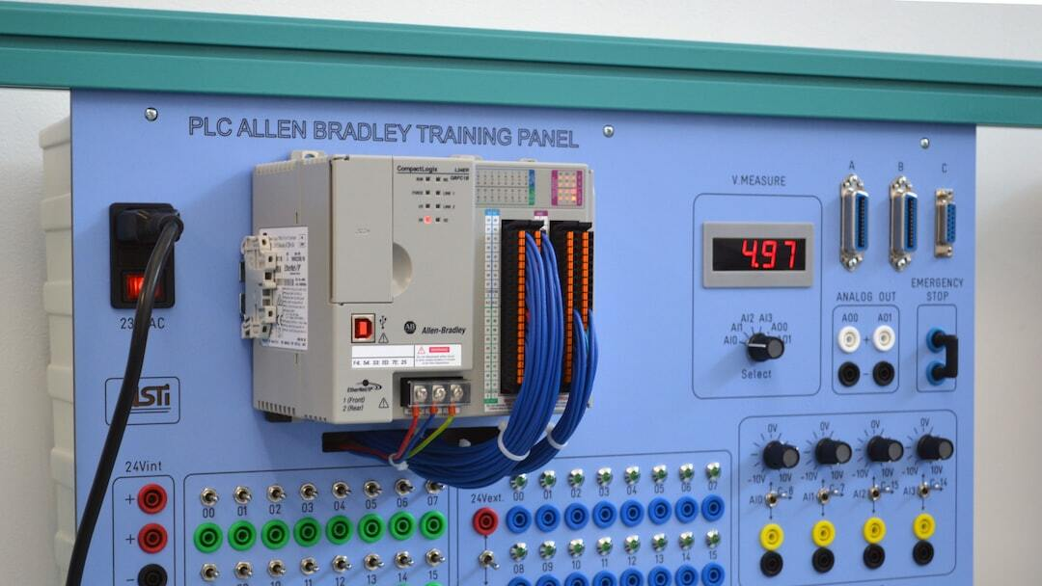
Solutions TO BE Implemented to improve power quality
Installation of Voltage Regulators: Installed voltage regulators to stabilize voltage levels and prevent equipment malfunctions during sags.
Implementation of Harmonic Filters: Deployed harmonic filters to reduce distortion and protect sensitive electronic equipment.
Use of Surge Protectors: Installed surge protectors to safeguard against transient over voltages and prevent equipment damage.

Slide 13
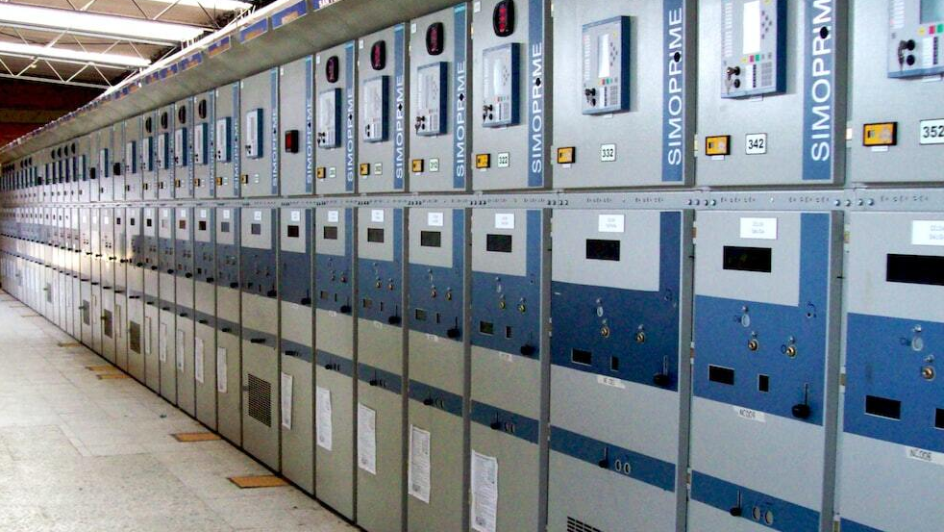
Detailed Analysis of Voltage Regulators
Function of Voltage Regulators: Voltage regulators maintain a constant voltage level to protect equipment from voltage fluctuations. They are essential in environments with sensitive electronics and variable loads.
Types of Voltage Regulators: Includes automatic voltage regulators (AVR), ferroresonant transformers, and electronic tap changers. Each type has specific applications based on the load and sensitivity of equipment.
Impact on Industrial Facility: Increased operational stability, reduced equipment malfunctions, and extended machinery lifespan due to consistent voltage supply.

Slide 14
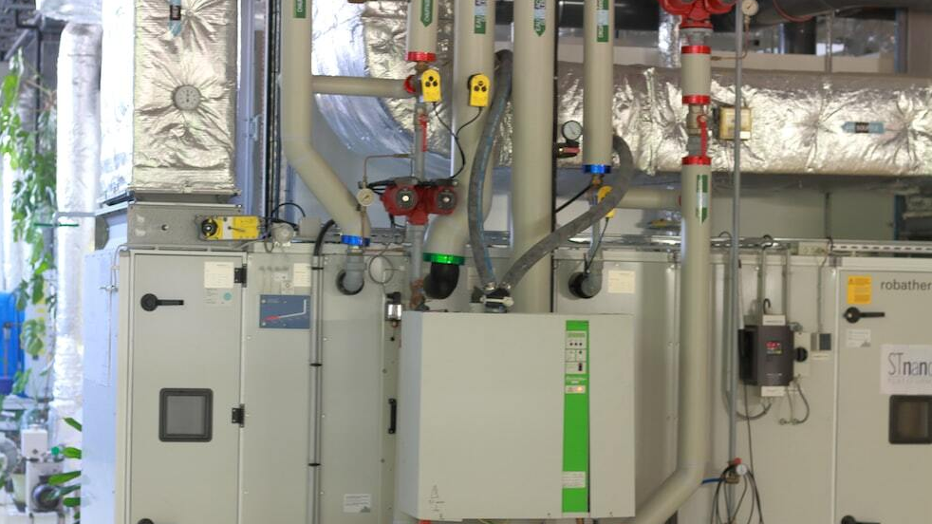
Detailed Analysis of Harmonic Filters
Function of Harmonic Filters: Harmonic filters mitigate harmonic distortion by filtering out unwanted harmonic frequencies. This ensures the power supply is cleaner and less disruptive to sensitive equipment.
Types of Harmonic Filters: Passive filters, active filters, and hybrid filters. Each type is selected based on the specific harmonic profile and the degree of distortion present.
Impact on Industrial Facility: Reduction in overheating and failure of electronic equipment, improved power factor, and enhanced overall system efficiency.

Slide 15
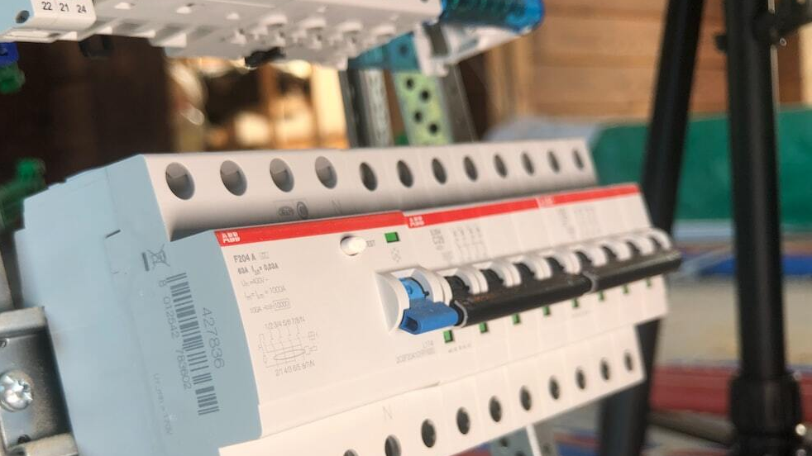
Detailed Analysis of Surge Protectors
Function of Surge Protectors: Surge protectors shield electrical devices from voltage spikes by diverting excess voltage away from sensitive components.
Types of Surge Protectors: Includes point-of-use surge protectors and whole-building surge protectors. Each type offers protection at different levels of the electrical system.
Impact on Industrial Facility: Enhanced protection against transient overvoltages, reduced risk of equipment damage, and increased reliability of the power system.

Slide 16
Oscilloscope or waveform analyser

Slide 17
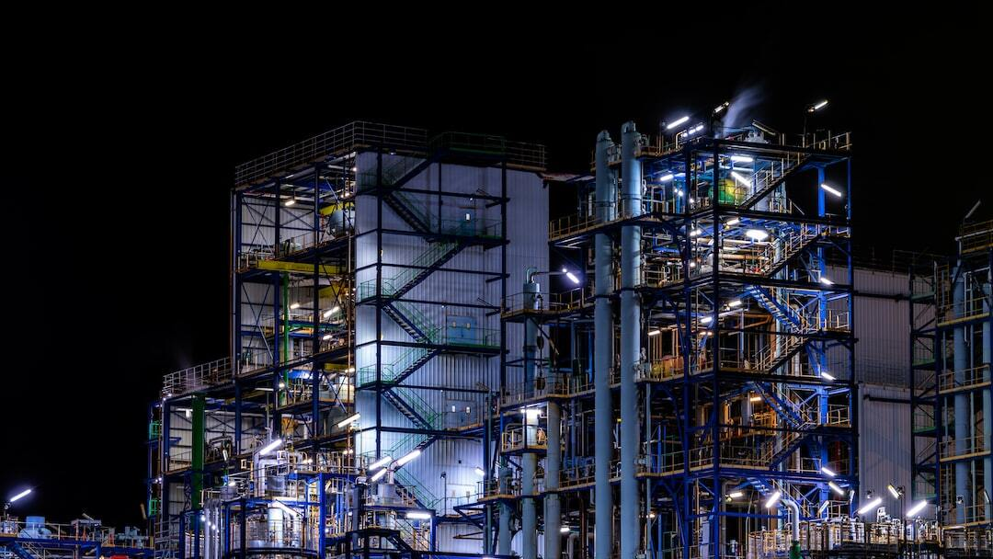
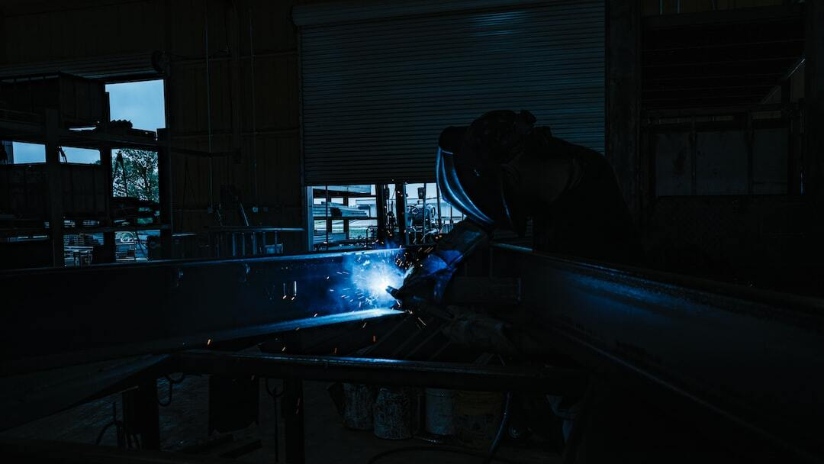

Slide 18
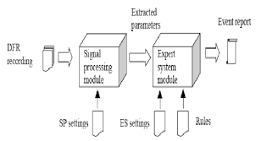
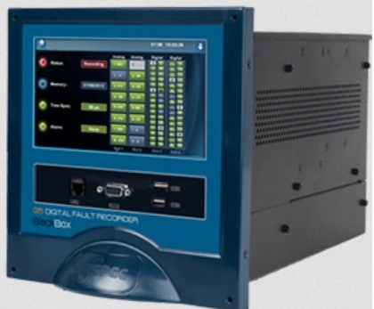
Digital fault recorder (dfr)
A digital fault recorder is a device that monitors and records disturbances in power systems by sampling binary data during transients.
They capture data such as harmonics, voltage levels, instantaneous waveforms signals of currents and voltages, short circuits, critical load cases, transformer breaking operations, line power fluctuations etc.
The information DFRs provide can also help engineering or management teams analyse power system processes and failures, which can improve efficiency and reliability

Slide 19
Impact on equipment by real-time monitoring
Improved Equipment Reliability: By continuously monitoring power quality parameters such as voltage levels, harmonics, and transients, industrial facilities can identify issues that could potentially damage equipment or cause malfunctions. Early detection allows for timely maintenance or corrective actions, thereby improving overall equipment reliability.
Reduced Downtime: Unplanned downtime due to power quality issues can be costly for industrial operations. Real-time monitoring helps in detecting and diagnosing problems quickly, allowing maintenance teams to take proactive measures to prevent equipment failures and minimize downtime.
Cost Savings: Proactively managing power quality can lead to cost savings in terms of reduced maintenance costs, lower energy consumption(by optimizing equipment efficiency), and minimized loses from production interruptions or equipment damage.
Overall, real-time power quality monitoring empowers industrial facilities to maintain a stable and reliable electrical supply, optimize equipment performance , and minimize operational risks and costs associated with power-related issues. It plays a crucial role in ensuring smooth and efficient industrial operations in today’s complex and interconnected manufacturing environments.

Slide 20
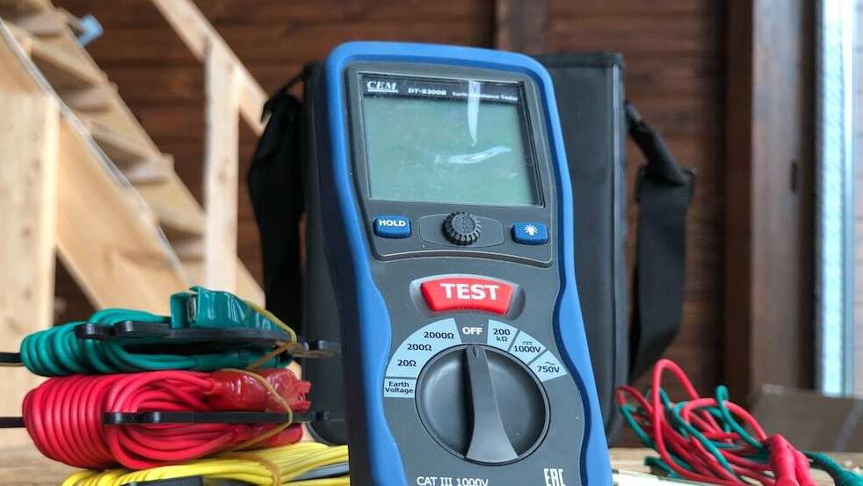
Practices of monitoring Power Quality Analysis
Real-Time Monitoring: Continuous assessment of power quality parameters using advanced monitoring systems to detect and address issues promptly.
Event-Based Monitoring: Captures specific power quality events, such as voltage sags or transients, for detailed analysis and reporting.
Periodic Audits: Scheduled inspections and measurements to ensure ongoing power quality compliance and identify trends over time using instruments like fluke 435.

Slide 21
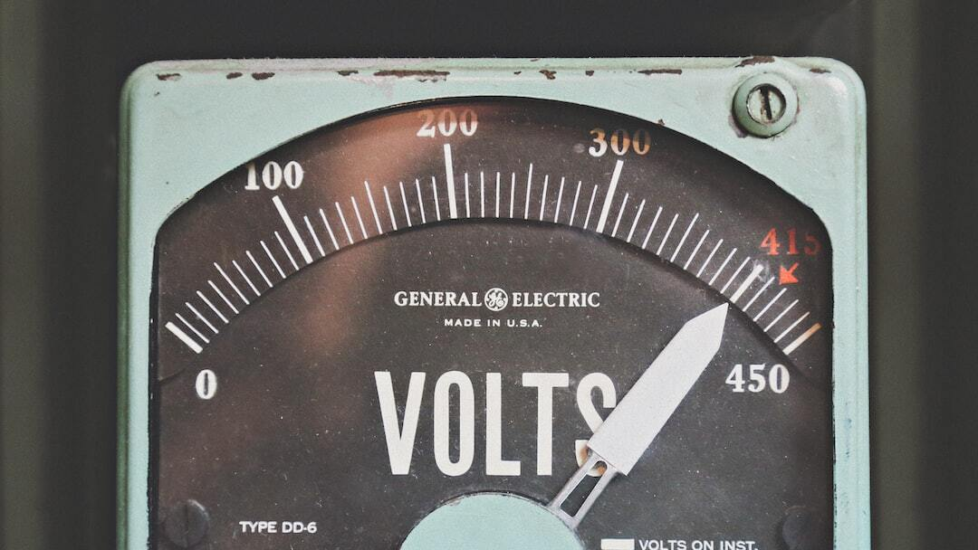
Key Factors responsible for Power quality disturbances
1. VOLTAGE
Overvoltage: Occurs when the voltage level exceeds the normal range, which can damage electrical equipment.
Undervoltage: Occurs when the voltage level drops below the normal range, leading to inefficiencies and potential equipment failure.
Voltage Sag and Swell: Short-duration drops (sags) or rises (swells) in voltage, often caused by sudden changes in load or faults in the power system.

Slide 22
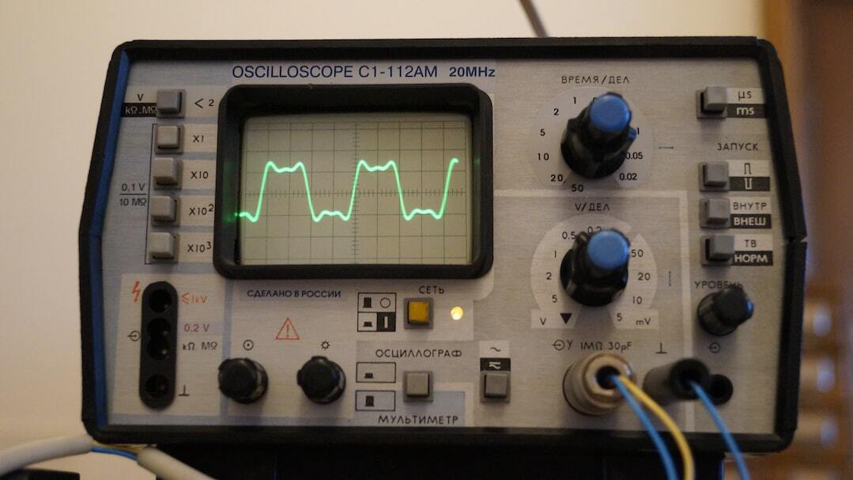
2. HARMONICS
Harmonics: Harmonics are voltage or current waveforms at frequencies that are multiples of the fundamental frequency, causing distortion in the power system.
Sources: Common sources include nonlinear loads such as diode bridge rectifiers, variable frequency drives, and fluorescent lighting.
Effects: Harmonics can cause overheating of equipment, interference with communication lines, and malfunctioning of sensitive devices.

Slide 23

Thank you

Slide 24
3. TRANSIENTS
Transient is an undesirable momentary deviation of supply voltage or load current. Such phenomena exists for a very short duration from less than 50 nanoseconds to as long as 50 milli seconds.
Sources: Lightning strikes, switching activities like opening and closing of disconnects on energized lines, capacitor bank switching etc.
Effects: Tripping, component failure, hardware reboot required, software ‘glitches’, poor product quality.
Impulsive transient
oscillatory transient

Slide 25
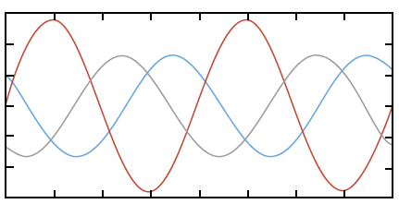
4. INTERRUPTIONS
Voltage imbalance is the deviation of magnitude and/or phase of one or many phases, of a three phase wrt the magnitude of the other phases and the normal phase angle(120 degree).
An Outage is defined as an interruption that has duration lasting more than one minute. A power outage (also known as power cut, power failure, power blackout, power loss) is the loss of electrical power supply to an end user.

Slide 26
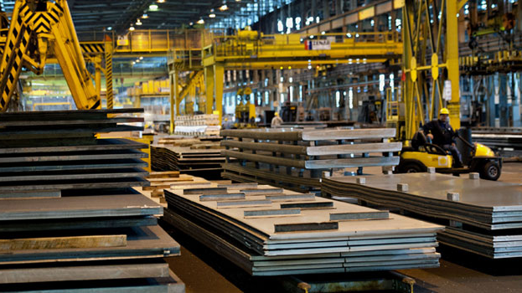
Case Study: Power Quality in Industrial Facility
Facility Description: A large manufacturing plant specializing in automotive parts with extensive use of heavy machinery and sensitive electronic equipment.
Operational Context: Operates 24/7 with high energy consumption and critical dependence on power quality for efficient and uninterrupted production.

